Slide 1




DIGITAL LITERACY
SKILLS
ADVANCED USERS

Slide 2

Module 3
Communication
and collaboration

Slide 3

2
Unit 2: Sharing through digital technologies

Slide 4
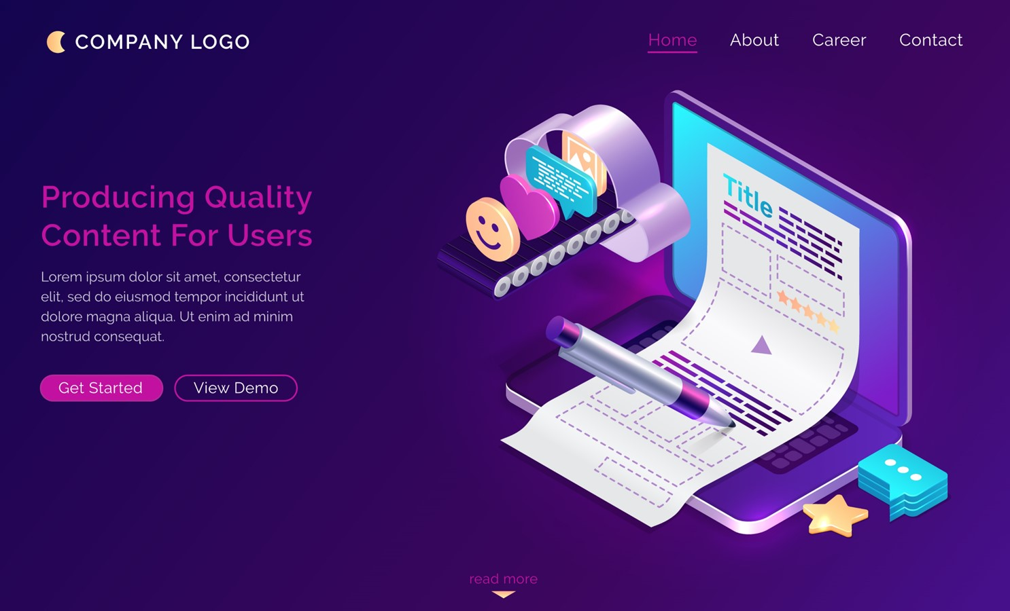
Sharing through Digital Technologies
The cloud has two distinct components:
Cloud computing
The service provider hosts applications that users run without installing those applications.
You can create documents without having to download and install the software.
Cloud computing saves space on your computer, the applications are always up to date, and you can run the applications from any device using your registered account.

Slide 5

Sharing through Digital Technologies
Cloud storage
Your files are stored in a secure and private location online.
It offers a reliable backup of information.
It allows for sharing of files, which allows collaborators to work on the same document at the same time.
It is updated with the latest files on your computer, if you are online.

Slide 6
Skills to practice
Create and manage content with collaboration tools (e.g., electronic calendars, project management systems, online proofing, online spreadsheets).
Open your email account, notice the calendar that is linked to your email account.
Open the calendar and create a meeting for each activity you have scheduled for the week.
Think of a friend or classmate who is involved in the same activities. Send them an invite to join the activity.
Write your English homework in a MS Word doc. Share it with a friend on Google Drive.
Edit your friend’s homework for any errors.

Slide 7
All back covers should include
contact information of the section
producing the work.
© United Nations Children’s Fund (UNICEF) [month and year of publication]

